Slide 1
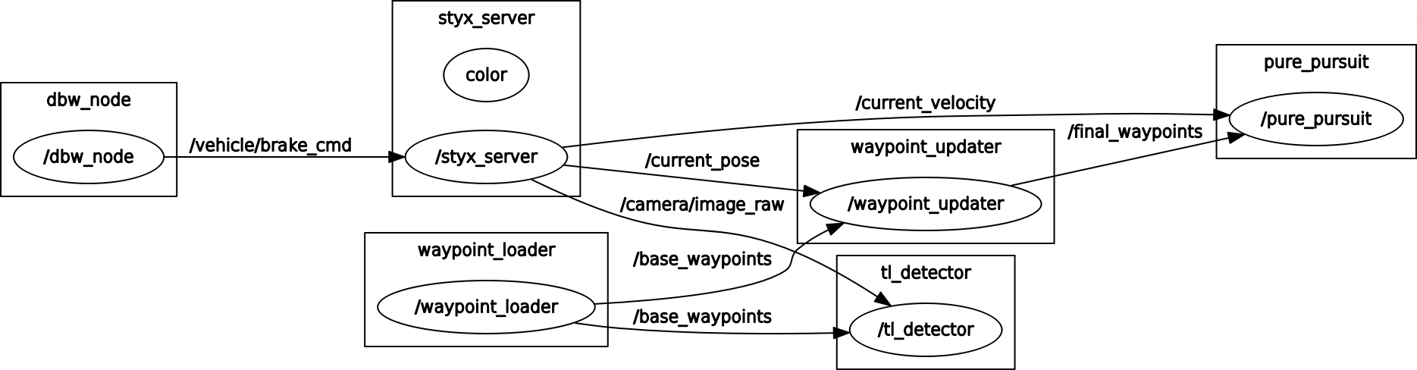
RQT Graph

Slide 2
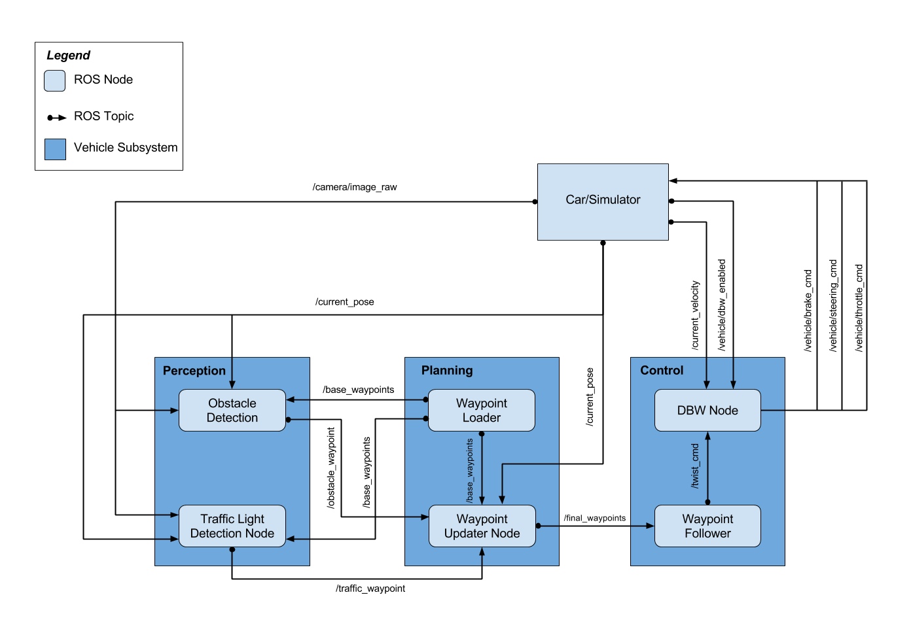
ROS Nodes Layout

Slide 3
Waypoint Files Summary
Filename | Column headers | Notes
churchlot_with_cars.csv | Pos x,y,z, yaw(rad) | Yaw is in rad (+/- Pi)
sim_waypoints.csv | Pos x,y,z, yaw(?) | Yaw is constant – bad? Same path as wpt_yaw and wpt_yaw_const
wp_yaw.txt | Pos x,y,z, yaw(deg) | Identical to wp_yaw_const.txt
wp_yaw_const.txt | Pos x,y,z, yaw(deg) | Identical to wp_yaw.txt Yaw is in deg(0-360)

Slide 4
churchlot_with_cars.csv
1 unit of distance traveled
between waypoints
Total Waypoints: 61
Distance Traveled Over Entire Waypoint Path: 68.4871
Column Headers: Pos x,Pos y, Pos z, yaw(rad)
Yaw goes from +/- pi (rad)

Slide 5
sim_waypoints.csv
Yaw angle bad?
Distance between waypoints
not constant, speed changing
Total Waypoints: 11011
Distance Traveled Over Entire Waypoint Path: 7014.1148
Column Headers: Pos x,Pos y, Pos z, yaw(rad)
Yaw is constant, doesn’t make sense

Slide 6
wpt_yaw_const.txt
Distance between waypoints
not constant, speed changing
Total Waypoints: 10902
Distance Traveled Over Entire Waypoint Path: 6968.739
Column Headers: Pos x,Pos y, Pos z, yaw(deg)
Yaw goes from 0 to 360 deg
Same path as sim_waypoints.csv, but yaw is correct in this file

Slide 7
wpt_yaw.txt
Distance between waypoints
not constant, speed changing
Total Waypoints: 10902
Distance Traveled Over Entire Waypoint Path: 6968.739
Column Headers: Pos x,Pos y, Pos z, yaw(deg)
Yaw goes from 0 to 360 deg
Same path as sim_waypoints.csv, but yaw is correct in this file

Slide 8
waypoint_loader.py
Random Notes:
0.27778 is km/hr to m/s conversion
3.6 is m/s to km/hr conversion
Output waypoints are in /world frame
Target speed set in launch file (in km/hr)
Function: Loads one of the csv files containing waypoints of the track and publishes them to /base_waypoints

Slide 9
waypoint_updater.py
Random Notes:
Hardcoded number of waypoints to publish (5)
Publishing more that 5-10 waypoints ahead causes simulator to lag
Implementation Details:
We find the closest n waypoints ahead of us and assign a linear speed to them
Similar to the path planning project, loop over all the base waypoints and find the closest one to our current position. This waypoint needs to be ahead of us so compute the bearing from current position to the waypoint. If bearing is positive then the waypoint is ahead.

Slide 10
waypoint_follower
Random Notes:
AKA pure_pursuit node
Not clear if this requires changes at this time
Produces estimated angular rate based on curvature of road, need to combine this with CTE control for steering control

Slide 11
twist_controller: launch files
3 launch files:
dbw.launch – runs dbw_node.py and sets params below
dbw_sim.launch – runs dbw_node.py and sets similar params
dbw_test.launch – loads rosbag dbw_test.rosbag.bag
Assigns topics from rosbag:
/vehicle/throttle_cmd = /actual/throttle_cmd
/vehicle/steering_cmd = /actual/steering_cmd
/vehicle/brake_cmd = /actual/brake_cmd
Parameters and their units:
param name="vehicle_mass" value="1736.35" (kilograms)
param name="fuel_capacity" value="13.5" (gallons)
param name="brake_deadband" value="0.1" (?)
param name="decel_limit" value="-5.0" (meters/sec/sec)
param name="accel_limit" value="1.0" (meters/sec/sec)
param name="wheel_radius" value="0.2413" (meters)
param name="wheel_base" value="2.8498" (meters)
param name="steer_ratio" value="14.8" (unitless)
param name="max_lat_accel" value="3.0" (meters/sec/sec)
param name="max_steer_angle" value="8.0" (rad)

Slide 12
twist_controller: dbw_node.py
This node calls the controller object in twistcontroller.py that has the controllers for throttle, steering and brakes, it publishes the final commands to the car/simulator.
Car model parameters are provided for use in the control design.
We read in the final waypoints from the waypoint updater to get the desired linear velocity and subtract current velocity to feed the throttle PID controller.
Waypoint follower (PurePursuit) provides the desired angular velocity that should be used in the yaw predictive controller. Still need to figure out how this works.
We compute CTE in this file similar to the MPC project last Term to feed the PID controller on steering.
Still need to figure out how to use brakes.
PID loops and low pass filters need to be tuned.

Slide 13
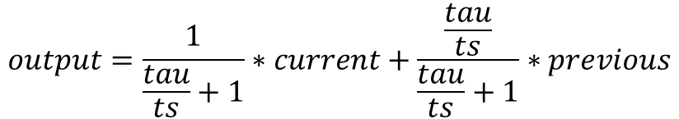
twist_controller: low_pass.py
Simple Low Pass Filter:
$$output=\frac{1}{\frac{tau}{ts}+1}∗current+\frac{\frac{tau}{ts}}{\frac{tau}{ts}+1}∗previous$$
tau =0, ts = 1 will shut off this filter

Slide 14
twist_controller: pid.py
INPUT
Error
Kp
1/Ts
Ki
prev
+
+
OUTPUT
Limits
1/Ts
Kd
-

